Slide 1
Spring 2019 Symposium:
DIGITAL ART &
BLOCKCHAIN

Slide 2
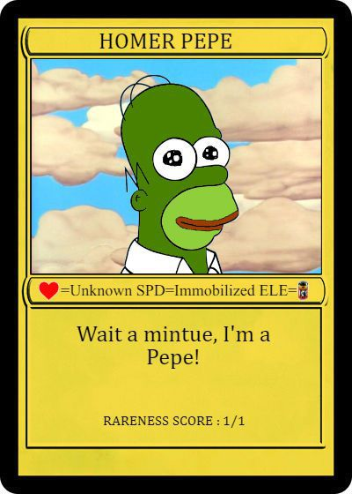
Rare Pepe

Slide 3
Rare Pepe

Slide 5
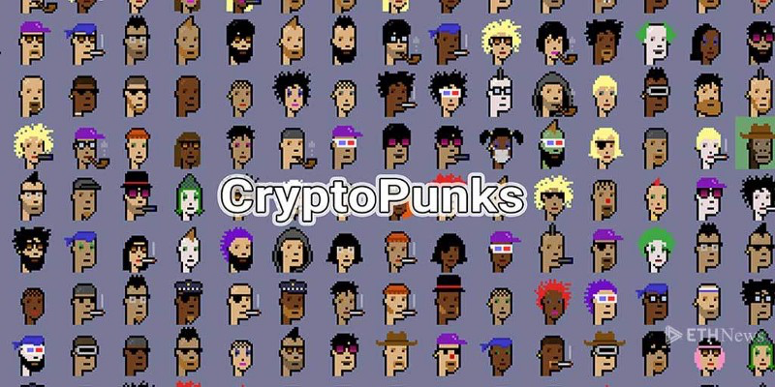

Slide 7
Found at dada.nyc

Slide 8
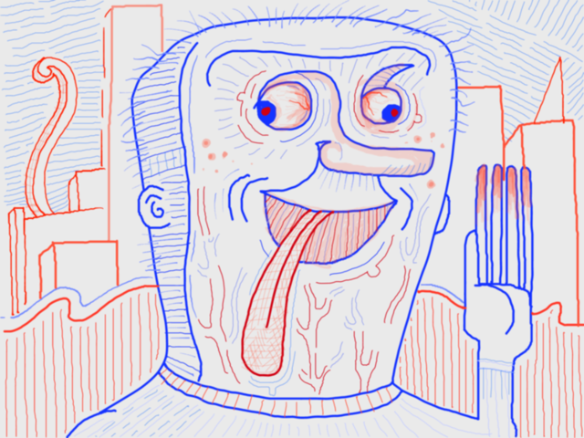
Found at dada.nyc

Slide 9
Cryptokitties

Slide 10
Cryptokitties

Slide 11
Spring 2019 Symposium:
DIGITAL ART &
BLOCKCHAIN

